Slide 1
LIFE AFTER JAVA 8
Popescu Ionut Cosmin – Ericsson Romania

Slide 2
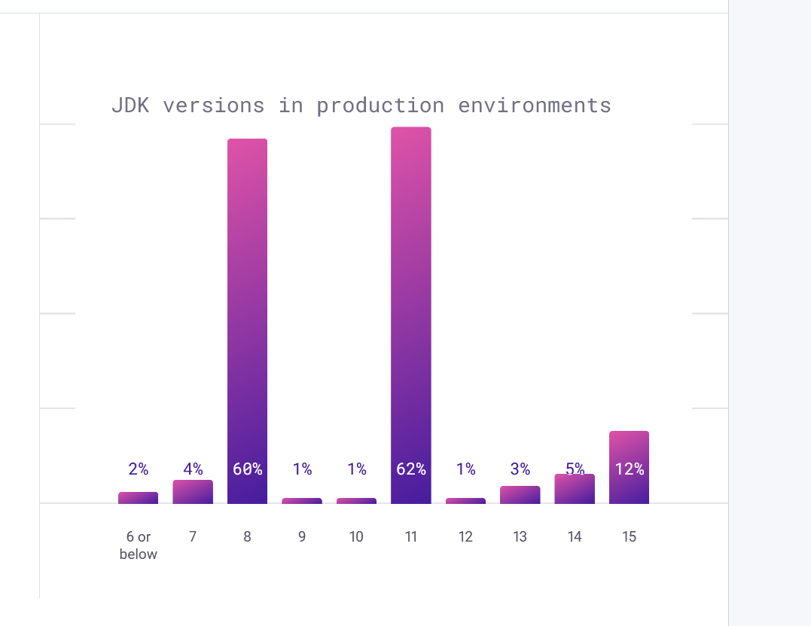
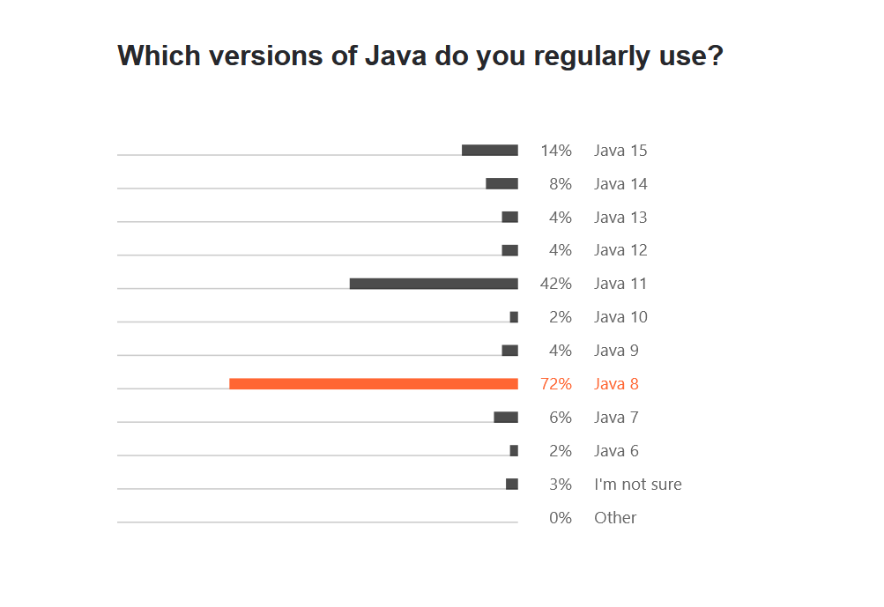
JAVA 8 RECAP I
Almost 10 years
Still strong

Slide 3
JAVA 8 RECAP II
Version that modernized the language
Streams API (map, filter, flatMap, collect, anyMatch)
Lambda expressions (C# had them since 3.0)
New API for date and time ()
Default methods in interfaces (C# will have it 5years later ☺ )

Slide 4
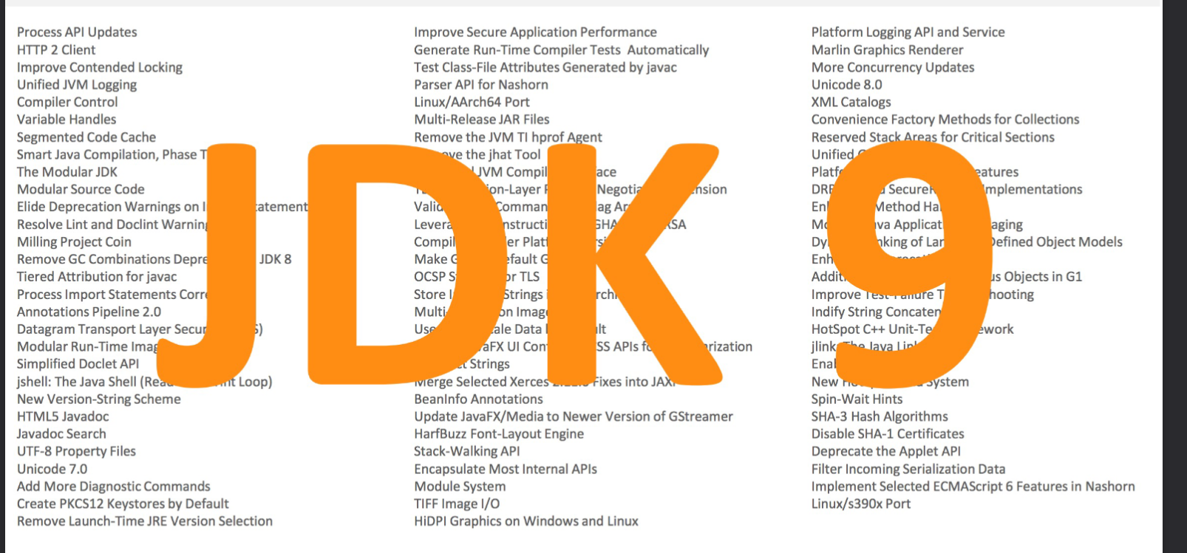
JDK 9

Slide 5
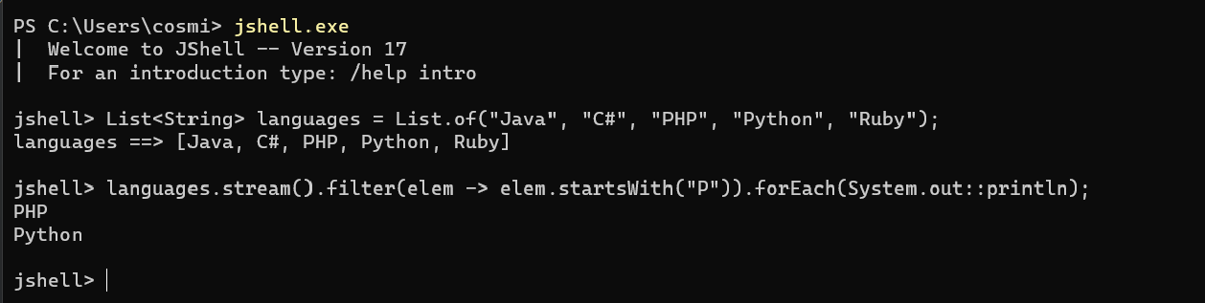
JDK 9 - I
Big And Small Changes
Java platform module system(some devs hate them.)
jlink – generate custom java runtime image with the necessary modules and dependencies to run the application.
Jshell – REPL shell for running Java code

Slide 6
JDK 9 - II
HTTP/2 Client (Incubator) – HTTP2 support, WebSockets
Support for Unicode 7 and 8
Convenience Factory Methods for Collections
Set<Integer> mySet = Set.of(1, 2, 3);
List<Integer> myList = List.of(1, 2, 3);
Map<String, Integer> myMap = Map.of("one", 1, "two", 2);

Slide 7
JDK 9 - III
New methods in Streams API (dropWhile, takeWhile, iterate, ofNullable)
Reactive Streams publish-subscribe framework – interface level. Implementations are provided by RxJava for example
Arrays.mismatch ☺
The great cleanup starts (deprecate Applet API ☺, Concurrent Mark Sweep Garbage Collector, Object.finalize()). This work will be carried on by the future JDKs.
Encapsulate Most Internal APIs (sun.misc.Unsafe)

Slide 8
JDK 10 - I
March 2018
Something amazing is happening ☺
Java gets var (C# has it since 2007 ☺ )
var userList = new ArrayList<String>(); // infers ArrayList<String> var stream = list.stream(); // infers Stream<String>
Verbosity will gradually start to reduce.

Slide 9
JDK 10 - II
Application Class-Data Sharing – improving startup footprint
New APIs (List, Set, Map.copyOf(Collection), Optional.orElseThrow(), Collectors. toUnmodifiable/List/Map/Set)
New Java release cycle. Two versions per years. Usually, spring and autumn.

Slide 10
JDK 11 - I
GA 09/2018
Long live the new LTS after Java 8
Java 11(Oracle JDK) trap (https://blog.joda.org/2018/09/do-not-fall-into-oracles-java-11-trap.html)
Our old friend, HTTP client from JDK 9 is standard now. Production ready
Local-Variable Syntax for Lambda Parameters ((var s1, var s2) -> s1 + s2). We can use also type annotations

Slide 11
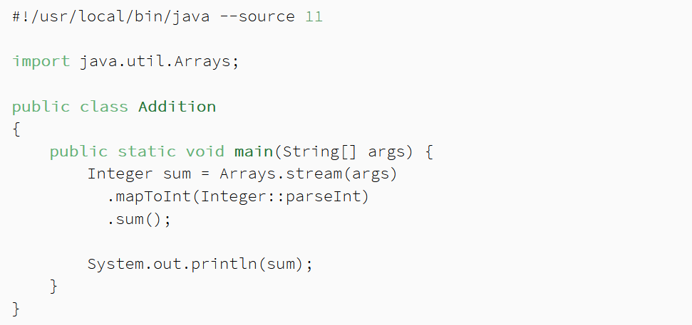
JDK 11 - II
Launch Single-File Source-Code Programs – launch a java program like a script, like python or php script
chmod +x MyProgram.java
./MyProgram.java 1 2 3

Slide 12
JDK 11 - III
Unicode 10
Deprecate the Nashorn JavaScript Engine
New cryptographic algorithms (ChaCha20 and Poly1305)
TLS 1.3
ZGC: Experimental low-latency garbage collector and Epsilon garbage collector
Flight Recorder
Remove the Java EE and CORBA Modules – careful with the update. No more JAXB

Slide 13
JDK 11 - IV
New APIs
Optional.isEmpty()
String.isBlank
String.repeat(int)
String strip()
String stripLeading()
String stripTrailing()
Predicate not(Predicate

Slide 14
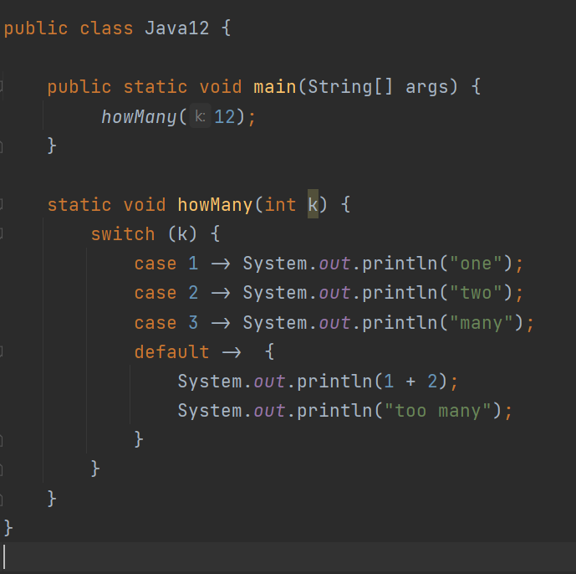
JDK 12 - I
03/2019
Shenandoah: A Low-Pause-Time Garbage Collector (Experimental)
Switch Expressions (Preview)
Not included in the Java SE standard Preview features require use of ––enable–preview flag
In JDK 13, it will be in the second preview

Slide 15
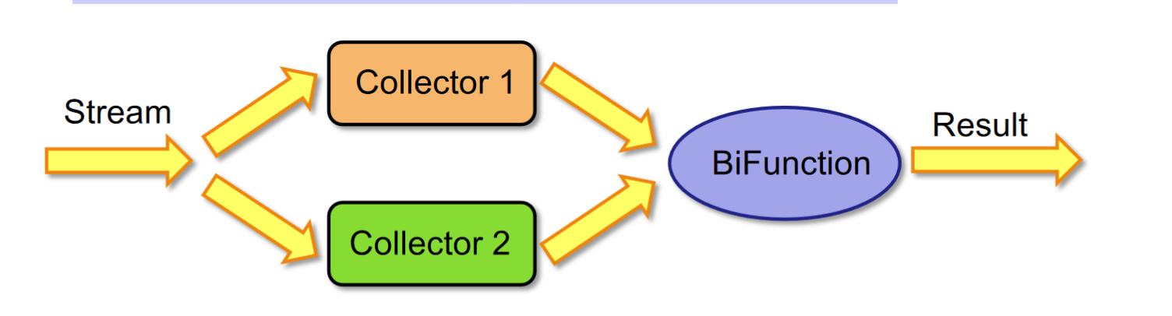
JDK 12 - II
Stream API gets a new collector – teeing (https://blog.frankel.ch/teeing-java-api/)
teeing(Collector, Collector, BiFunction)
Collect a stream using two collectors
Use a BiFunction to merge the two collections
tee is a Linux command ☺

Slide 16
JDK 13 - I
09/2019
Only 5 JEPs ☺
Switch expressions (Second preview)
Text blocks (preview)
String html = """
<html>
<body>
<p>Hello, world</p>
</body>
</html>
""";

Slide 17
JDK 13 - II
Reimplement the Legacy Socket API – easy to adopt to work with Project Loom

Slide 18
JDK 14 - I
03/2020 ☺
Pattern Matching for instanceof (Preview) – and pattern matching is in Scala, C#, Haskell. It allows the desired 'shape' of an object to be expressed concisely (the pattern), and for various statements and expressions to test that 'shape' against their input (the matching).
if (obj instanceof String s) {
// can use s here
} else {
// can't use s here
}

Slide 19
JDK 14 - II
Helpful NullPointerExceptions - improve the usability of NullPointerExceptions generated by the JVM by describing precisely which variable was null.
Records – Java will have it first. In Kotlin – data class.
Compact syntax for declaring classes which are transparent holders for shallowly immutable data.
record Point(int x, int y) {} // the compiler takes care of everything

Slide 20
JDK 14 - III
Text Blocks (Second Preview) – two new escape sequences
Foreign-Memory Access API (Incubator) - allow Java programs to safely and efficiently access foreign memory outside of the Java heap.
Packaging Tool (Incubator) – package the applications as a msi or exe, deb, rpm
Deprecations
Solaris and SPARC Ports
Pack200 Tools and API
ParallelScavenge + SerialOld GC Combination

Slide 21
JDK 15 - I
09/2020
Sealed Classes (Preview) - Enhance the Java programming language with sealed classes and interfaces. Sealed classes and interfaces restrict which other classes or interfaces may extend or implement them.
package com.example.geometry;
public abstract sealed class Shape
permits Circle, Rectangle, Square {...}

Slide 22
JDK 15 - II
Pattern Matching for instanceof (Second Preview)
Shenandoah: A Low-Pause-Time Garbage Collector (Production) – from experimental to profuction
Records (Second Preview) – local records, annotations on records
Foreign-Memory Access API (Second Incubator) – refinements
ZGC (Production)
Remove the Nashorn JavaScript Engine
Reimplement the Legacy DatagramSocket API

Slide 23
JDK 16 - I
03/2021
Records and pattern matching for instanceof are final in this JDK
Sealed classes (second preview)
Vector API (Incubator) – vector computations to use hardware instructions on supported CPU architectures
Ports for Alpine Linux and Windows/AArch64
Unix-Domain Socket Channels (https://www.morling.dev/blog/talking-to-postgres-through-java-16-unix-domain-socket-channels/)

Slide 24
JDK 17 I
09/2021
Long live again the new LTS
Oracle JDK – free ☺
Sealed Classes – delivered
Pattern Matching for switch (Preview) - https://openjdk.java.net/jeps/406
Strongly Encapsulate JDK Internals – developers should use standard apis for increased security and maintainability.
Sealed Classes – no changes from JDK 16
macOS/AArch64 Port – Port for the new Apple M1

Slide 25
JDK 17 - II
Vector API (Second Incubator)
Foreign Function & Memory API (Incubator)
Deprecate the Security Manager for Removal
Deprecate the Applet API for Removal – will be removed for sure

Slide 26
Project to follow in Java world
Besides the new shiny JEPs there are many projects in OpenJDK world for further improving the language
Project Loom
Project Valhalla
GraalVM

Slide 27
Project Loom
Easy-to-use, high-throughput lightweight concurrency and new programming models on the Java platform
Virtual threads (Go has goroutines) – threads managed by JVM
Delimited continuations
Tail-call elimination
There are builds - http://jdk.java.net/loom/ - based on incomplete versions of JDKs
A nice presentation about green threads

Slide 28
Project Valhalla - I
Inline types - Codes like a class, works like an int!
Immutable and not nullable, have a default value
inline public class Point {
public int x;
public int y;
public Point(int x, int y) {
this.x = x;
this.y = y;
}

Slide 29
Project Valhalla - II
Generics over Primitive Types – List<Integer> vs List<int>
No one knows when will be finished

Slide 30
Project Panama
Interconnecting JVM and native code
The Foreign-Memory Access API
The Foreign Linker API
The Vector API
https://github.com/carldea/panama4newbies - explore the project

Slide 31
Java for cloud, microservices
Yeah, Java can do that ☺
Spring Boot
Quarkus, Micronaut
Docker, K8S

Slide 32
Conclusion
Is Java a bad language – NO
Is Java sometimes too verbose – mmmmmyeah ☺
Is <insert_your_favourite_language> better than Java – Some ideas can be better executed. ☺

Slide 33
THANK YOU ☺

